Slide 1
Sound Waves

Slide 2

By the end of this Smart Lesson, you should be able to:
1. | State how sound waves are formed.
2. | Describe how sound waves affect the particles in a medium.
3. | Outline the relationship between frequency and pitch.
4. | Outline the relationship between amplitude and loudness.

Slide 3

Sound is produced by vibrations.
Sound is produced by vibrating objects, such as the vocal cords in your throat.
These vibrating objects cause the particles in the surrounding medium to vibrate as well.
A medium is anything which contains particles. If there are no particles or particles that are spread extremely far apart, the sound wave cannot travel. This is why sound can't travel through the vacuum of space!

Slide 4


Slide 5
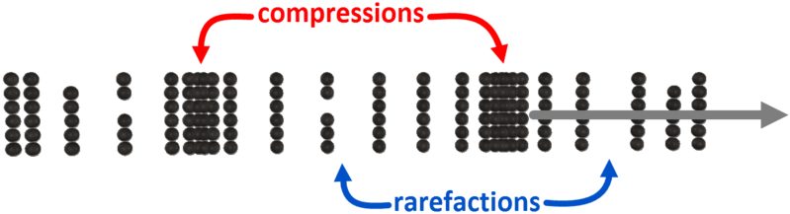
Vibrations cause particles to move.
The particles in the medium either bunch together or spread apart in response to the vibrating object.
When the particles are bunched together we say that it is a compression.
When the particles are spread out it is called a rarefaction.

Slide 6

A sound wave is a series of compressions and rarefactions.
Sound waves move away from the vibrating object.
Sound is a longitudinal wave. This is because the particles vibrate in the same direction that the wave travels in.
This animation shows how longitudinal waves are made up of compressions and rarefactions.

Slide 7

The speed which a sound wave moves at depends on the medium it is in.
When the particles are closer together the sound wave will travel faster.
This means that sound travels faster in solids than liquids, and faster in liquids than gases.

Slide 8
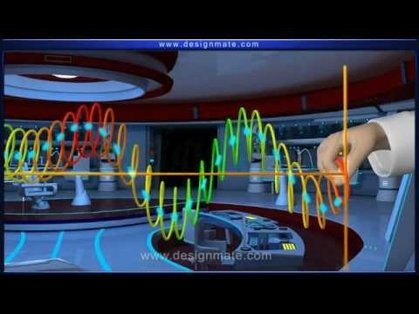

Slide 9

There are a few important characteristics which are shared by every wave.
These are:
frequency
wavelength
amplitude
Pitch is how high or low a sound is. It is determined by the frequency and wavelength of a wave.

Slide 10
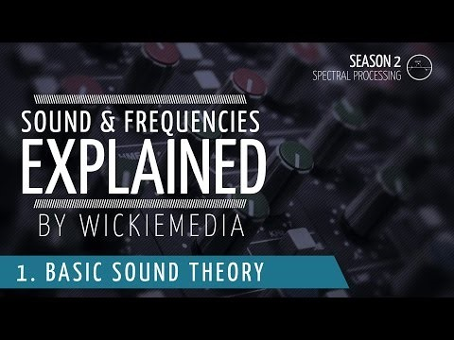

Slide 11

The frequency of a wave is caused by the number of vibrations a sound source makes each second.
We can think of frequency as the number of compressions which pass a certain point in one second.
Frequency has the unit Hertz, which is also written as Hz.

Slide 12
The wavelength of a wave is how long the wave is. It is the distance from one compression to another.
Wavelength has the unit metres (m).

Slide 13
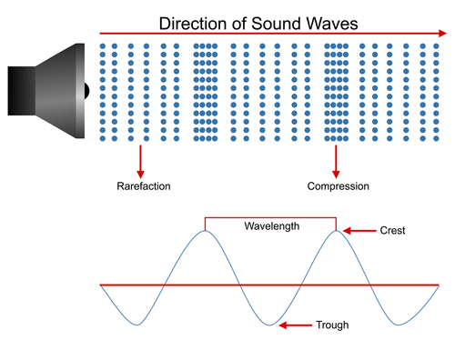
This diagram shows how we can express a sound wave as a curve.

Slide 14
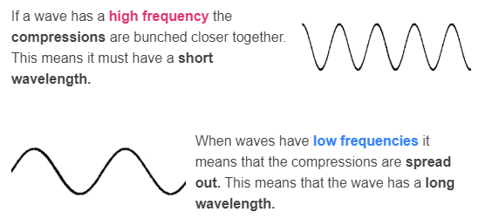
Wavelength and frequency are linked together.

Slide 15
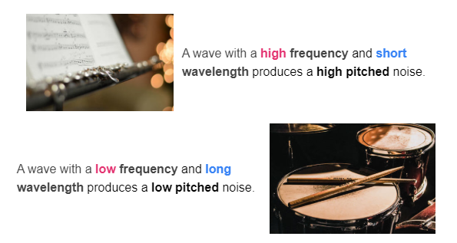
Both the wavelength and frequency affect the sound produced.

Slide 16

Some sounds are louder than other sounds.
Now we know how we can produce high pitched or low pitched sounds, but how do we produce noises which are loud or quiet?
The answer lies in something called amplitude.
This is the amount of vibration which occurs as a sound wave passes through a medium.

Slide 17
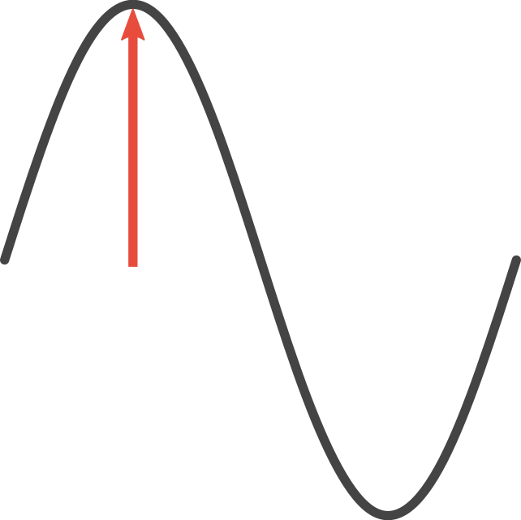
Amplitude is directly linked to the volume of a sound.
If there is more vibration the wave has a larger amplitude. This produces a loud sound.
If there is less vibration the wave has a smaller amplitude. This means the sound is quiet.

Slide 18
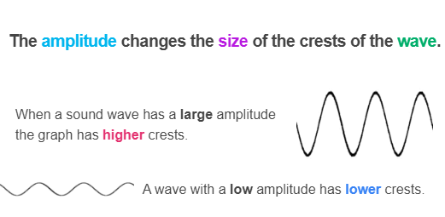

Slide 19


Slide 20
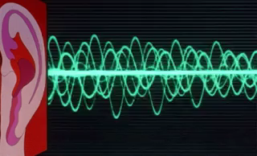
We use the decibel scale to measure the sound level of a noise.
The unit of the decibel scale is the decibel (dB). This tells us how loud a sound is.
However, the decibel scale isn't perfect because our ears are more sensitive to some sounds than others.

Slide 21

The decibel scale is used to measure how loud a sound is.
It is a logarithmic scale. This means that if a sound is twice as loud, the sound level increases by 10 dB. This is kind of weird, but it gives us nicer numbers to work with.

